Slide 1

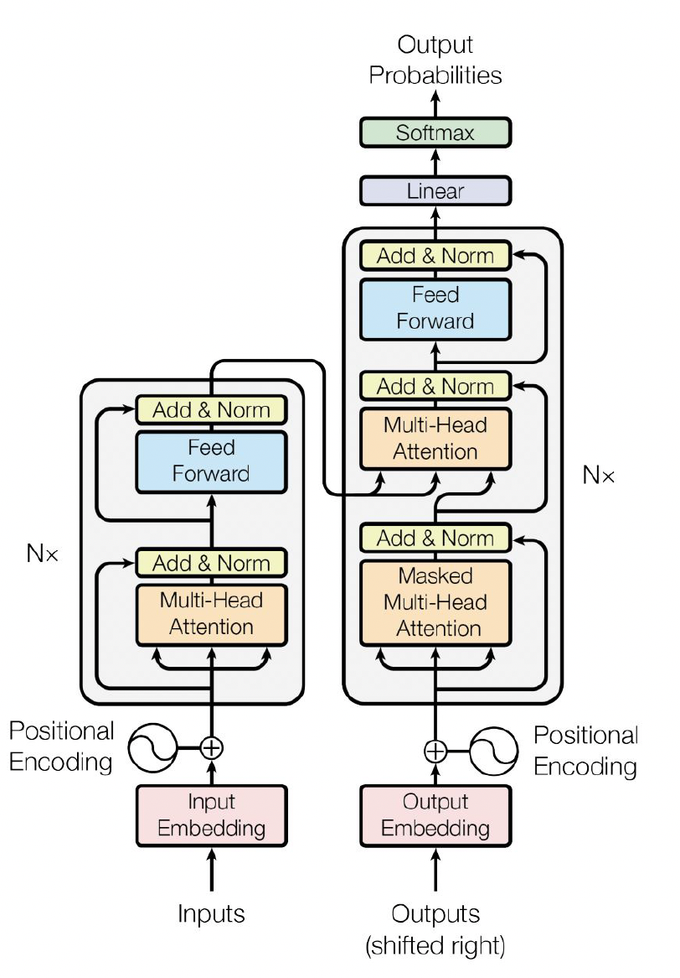
C3: Transformers (not the movie)

Slide 2

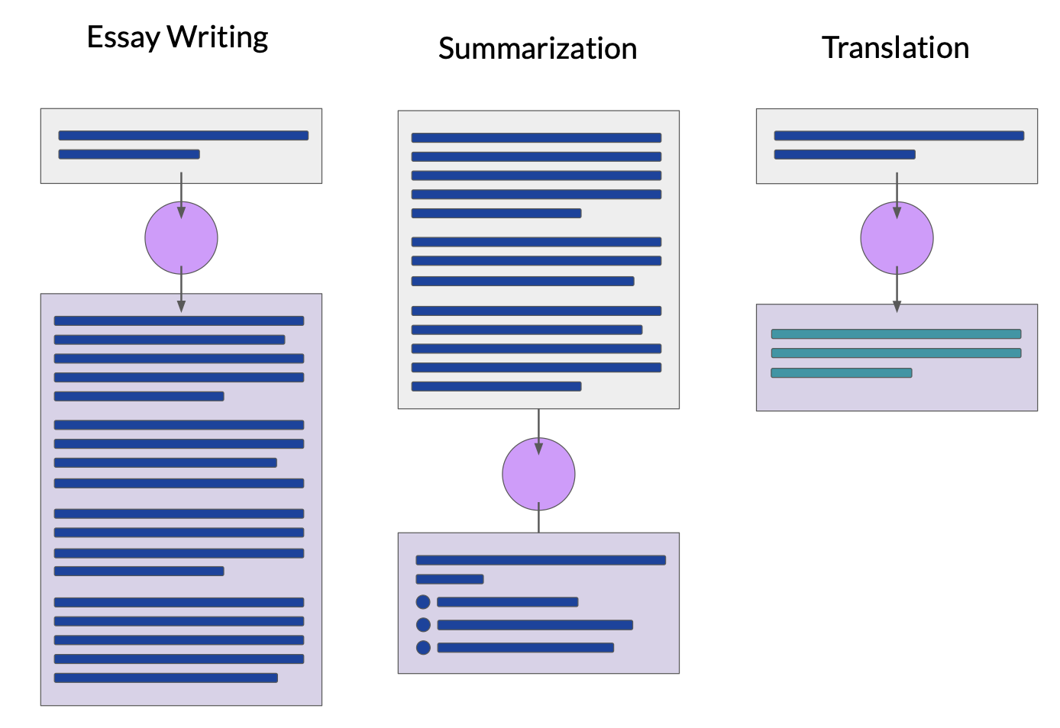
Text generation is not trivial
Input
Output

Slide 3
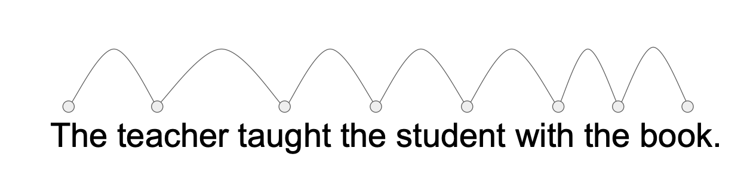
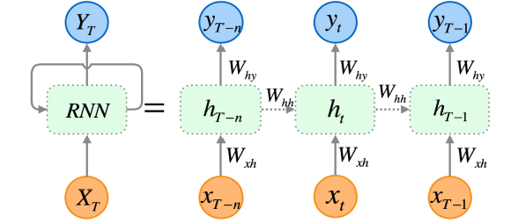
1st attempt – Recurrent neural networks
Input: [1, 2, 3….]
F(1), F(2, F(1)), F(3, (F(2, F(1))….)
- reads words one by one in sequence.
- at each step, it remembers what it has seen before and predicts the next word. How it generates words ? - it starts with a seed word and predicts the next word.
that new word is fed back into the model to generate the next one, and so on.
Limitations:
since it processes words sequentially, it can struggle to remember information from far back in the text
vanishing gradient problem due to repeated multiplications

Slide 4
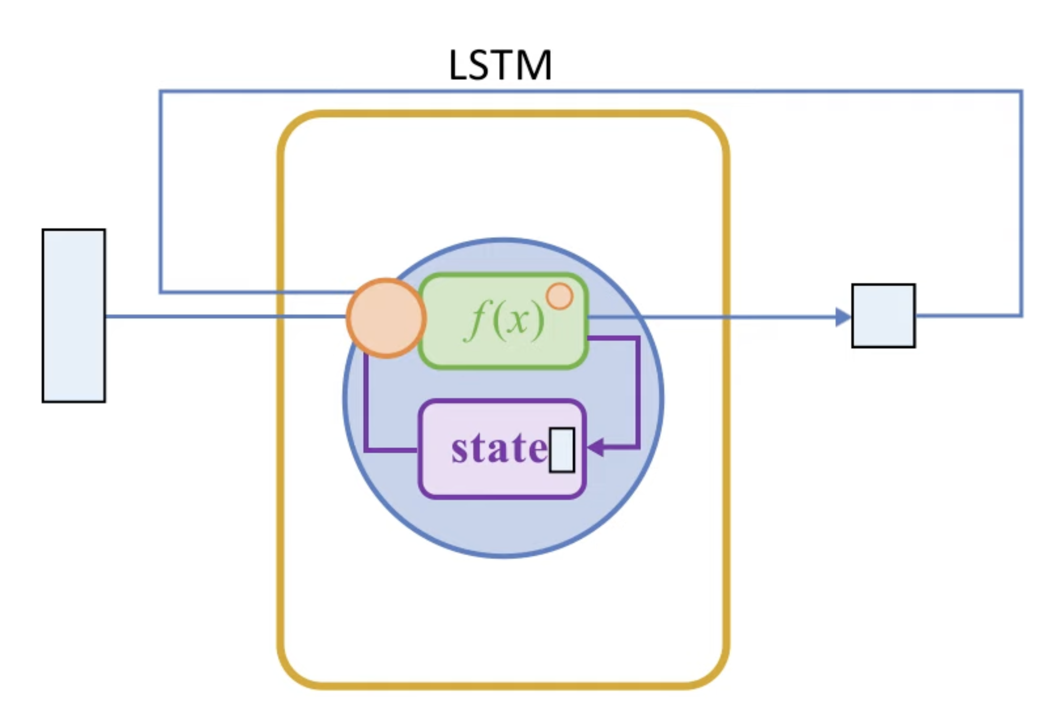
2nd attempt – Long Short-Term Memory (LSTM)
1. It reads a word and decides what past info is important (Forget Gate).
2. It updates its memory by adding new relevant info (Input Gate).
3. It produces an output based on what it currently knows (Output Gate).
Forget Gate - What to remove?
- Decides which information should be forgotten from the cell state.
- Uses a sigmoid activation: values close to 0 mean “forget,” values near 1 mean “keep.”
Input Gate - What to remember?
- Decides which new information should be added to the memory.
- Uses a sigmoid to filter important inputs and a tanh to regulate how much to store.
Output Gate - What to use now?
- Decides what part of the cell state should be output at the current step.
- Uses sigmoid + tanh to generate the final hidden state.

Slide 5

Also Problems with embeddings (word2vec)
Static embeddings don’t adapt! The meaning of a word remains the same regardless of context.
The chicken didn't cross the road because it was too tired
Here, “it” could refer to “the chicken”, but a static embedding treats “it” the same in every sentence, without knowing what it refers to.

Slide 6
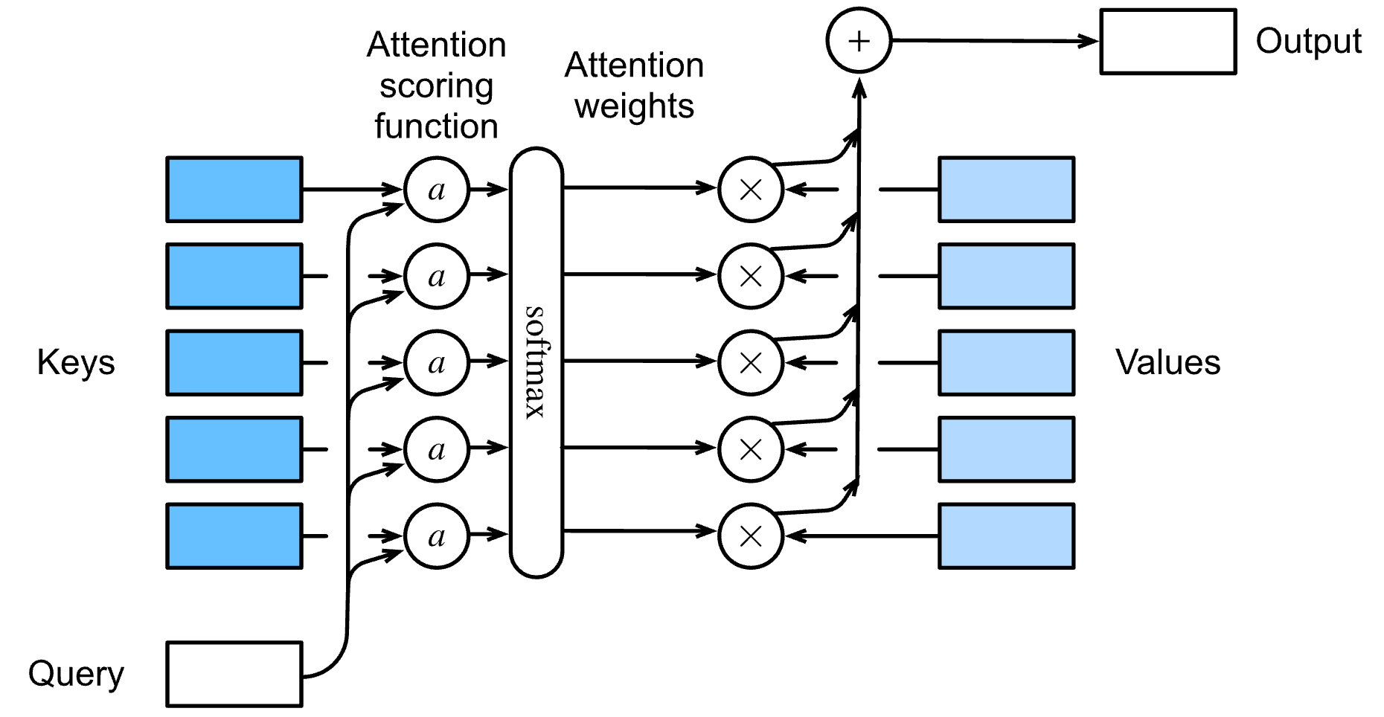
Solution: Contextual Embeddings
Intuition: The significance of a word varies based on its context!
Contextual Embeddings: Each word is represented by unique vectors that capture different meanings influenced by adjacent words.
How can we calculate contextual embeddings?
Attention mechanisms! (2014)

Slide 7
Solution: Contextual Embeddings
The process of building contextual embeddings involves selectively incorporating data from surrounding words.
A specific word "focuses on" or gives more importance to certain neighboring words over others, using attention mechanisms.
This selective focus helps in constructing a rich contextual embedding that accurately reflects the word’s meaning within its unique context.
This approach allows the model to dynamically weigh the influence of each neighbor, enhancing understanding and representation of words based on their context.

Slide 8
Solution: Contextual Embeddings
x1 x2 x3 x4 x5 x6 x7 xi

Slide 9
!ATTENTION!
Attention is left to right
The attention mechanism computes token embeddings by selectively focusing on and integrating information from surrounding tokens, enhancing contextual relevance based on their significance at the previous layer.

Slide 10
!ATTENTION!
Given a sequence of token embeddings:
x₁ x₂ x₃ x₄ x₅ x₆ x₇ x_{i}
Produce: a_{i} = a weighted sum of x₁ through x₇ (and x_{i})
Weighted by their similarity to x_{i}
1. Compare words: Each word embedding is compared to the current word (xi) using a dot product to measure similarity.
2. Assign weights: Words that are more similar get higher weights, meaning they contribute more to the final output.
3. Normalize weights: The scores are turned into probabilities using softmax, ensuring they add up to 1.
4. Weighted sum: The final attention output (ai) is a mix of all previous words, but more influenced by the most relevant ones.
x1 x2 x3 x4 x5 x6 x7 xi

Slide 11
!ATTENTION!
Instead of treating words as just vectors, we assign them three roles:
Query (Q) – The current word looking for relevant information.
Q - Each word asks: Which past words matter?
Key (K) – A past word being evaluated for relevance.
K - Each past word answers: Am I relevant?
Value (V) – The actual information from a past word that gets used if it’s relevant.
V - If relevant, its value is used to enhance understanding.
input
x1 x2 x3 x4 x5 x6 x7 xi
keys
k
k
k
k
k
k
k
k
values
v
v
v
v
v
v
v
v

Slide 12
!ONE ATTENTION head!
Attention layer computes 3 matrices:
query: W^{Q}
key: W^{K}
value: W^{V}
which will contain the representation of each x_{i} as query, key, value:
- similarity of element x_{i} with a prior element x_{j} -> q_{i} and k_{j}.
- instead of summing up x_{j} , we sum up v_{j}

Slide 13
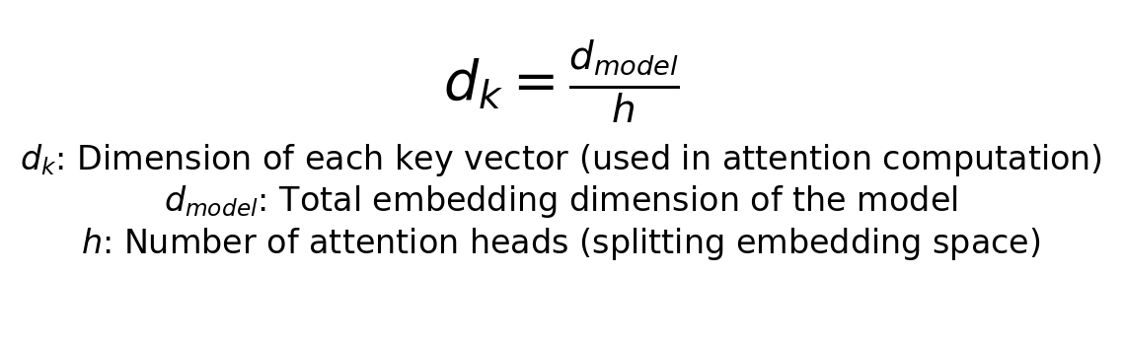
!ONE ATTENTION head!
Example:

Slide 14
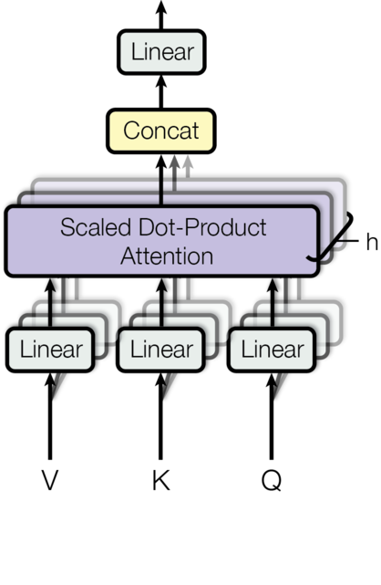
!Multi-head attention!
different “contexts”

Slide 15
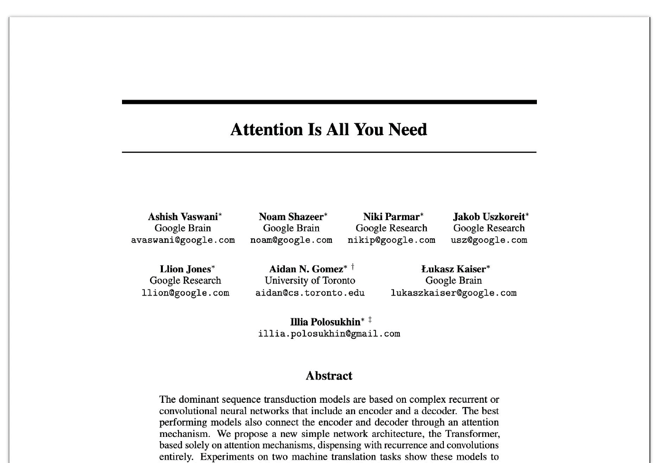
Transformer architecture
2017

Slide 16
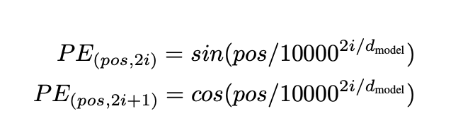
Transformer architecture
Repeated N times (N blocks) (1) we look at pairs
(2) we look at pairs of pairs
(3) we loot at pairs of pairs of pairs
encoder
Final rich representation
applying non-linearity and transformation
stability and learning efficiency Norm(X + SelfAttention(X))
Q, K, V
preserve order
word embeddings

Slide 17
Transformer architecture
decoder
probability distribution
combines context + masked prediction
hides future tokens so it can’t peek ahead while generating text
needed for training
Token | The | cat | sat | on | the | mat
The | ✅ | X | X | X | X | X
cat | ✅ | ✅ | X | X | X | X
sat | ✅ | ✅ | ✅ | X | X | X
on | ✅ | ✅ | ✅ | ✅ | X | X
the | ✅ | ✅ | ✅ | ✅ | ✅ | X

Slide 18
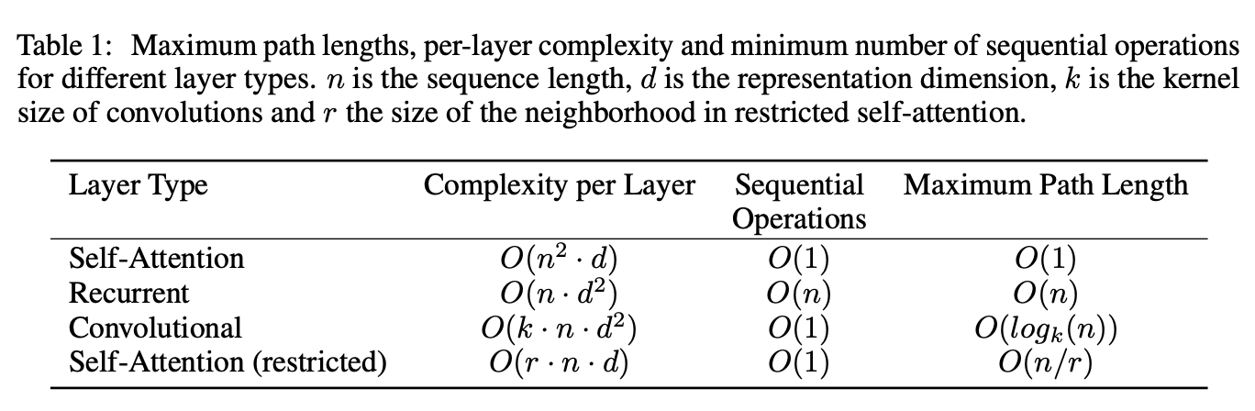
Transformer architecture

Slide 19
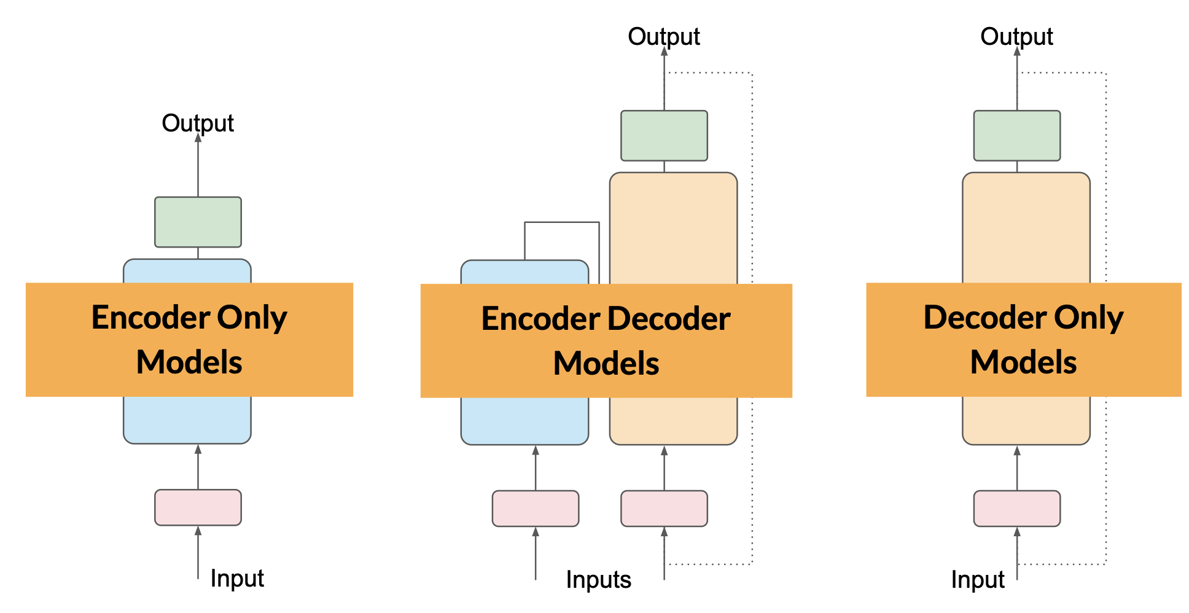
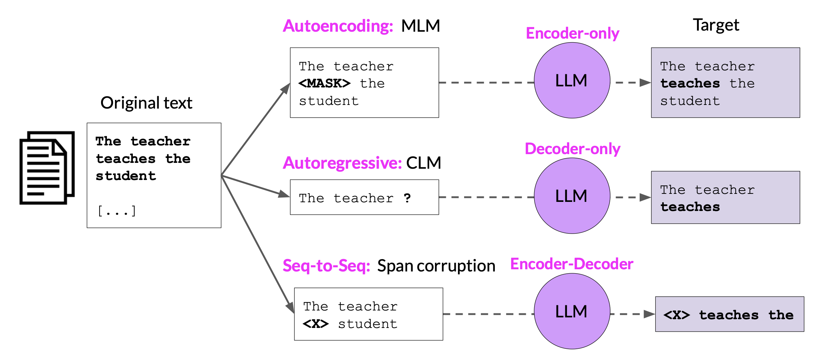
Transformer architecture
Masked Language Modeling
Bert
Text analysis
(sentiment analysis) NER
Causal Language Modeling
GPT
Text generation Dialog models
T5
Text summarization Machine translation

Slide 20
Resources
3Blue1Brown – best vizualizations on Earth
https://www.youtube.com/watch?v=wjZofJX0v4M&t=411s
Attention is all you need paper
https://arxiv.org/abs/1706.03762
LLM visualization (GPT) https://bbycroft.net/llm

